Slide 1
A few thoughts on Cloud Procurement
04 November 2019
Rudolf Dimper – ESRF

Slide 2
From the proposal
Task 6.8 Procurement of commercial Cloud Services (M30-M42)
Commercial cloud services may constitute an important alternative “scale-out” solution for peak demands of data analysis needs in the RIs. However, as of today the RIs do not have adequate mechanisms in place to procure and use commercial cloud services in a flexible and secure manner. This task will allow to tender commercial cloud services for all partners in a mutualised manner and acquire practical experience of how to allocate resources to individual scientists. Although initially targeted at “in-house” scientists it may at a later stage allow to enlarge the service offering of the RIs. The procurement activity will profit from experience with the e-Infrastructures, but also from the PCP procurement project HNSciCloud led by CERN. This task will require to work in close relationship with the purchasing departments of the partner RIs.

Slide 3
The easy way – just buy IaaS
Contact a broker
Conclude a contract for 20k€ for AWS
Ask the broker to install an individual AWS account for each partner
Each partner designates a technical contact to help internal users access the cloud resources
Each partner monitors the AWS cloud usage, the broker makes the accounting, the ESRF sends orders to the broker when required until the 100k€ are exhausted
Each partner acquires experience with AWS and reports problems for sharing between partners

Slide 4
To be checked
Is a broker still required/useful? (costs ~5% more)
Can we procure avoiding the EU procurement rules? (EU tendering rules normally only kick in >144k€)
Does it make sense to tender?
Why Amazon and not Azure or Google?
Is it OK for partners to deal with a non EU cloud provider?

Slide 5
The more complicated way
Go for a full tender exercise
Contact CERN to use the specifications for HNSciCloud as a starting point
Which rules to apply? EU tender rules or ESRF financial rules?
Would most likely only interest small EU cloud providers
Same usage mechanism, i.e. one cloud account per partner
My take on this:
No tendering for 100k€, AWS has a mature and rich portal, OK to anticipate task 6.8

Slide 6
More on task 6.8
The statement “work in close relationship with the purchasing departments of the partner RIs” requires a more structural work
One way to approach this would be to draft joint specifications for future cloud tendering
This would allow addressing all functional and operational issues such as monitoring, accounting, access, data transfer, vendor lock-in, etc. and prepare the ground for cloud procurement “beyond PaNOSC”

Slide 7
EU procurement projects
HNSCiCloud Pre Commercial Procurement
Initiated by ESA, EMBL and CERN, then managed by CERN
1/3 financed by partners, 2/3 by EU
Had to include a significant development component
Had to follow EU tendering procedure → required a derogation from the CERN council for not following CERN tendering rules!
Ended 31/12/2018

Slide 8
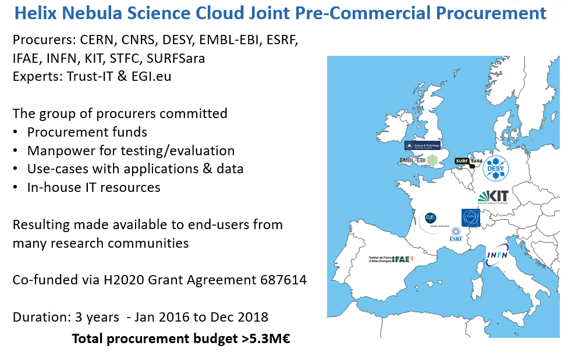

Slide 9
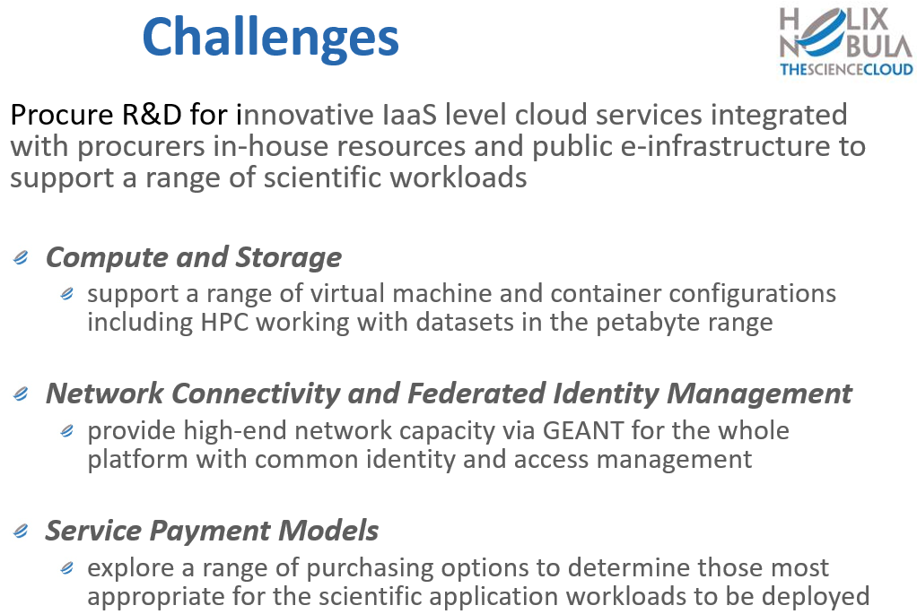

Slide 10
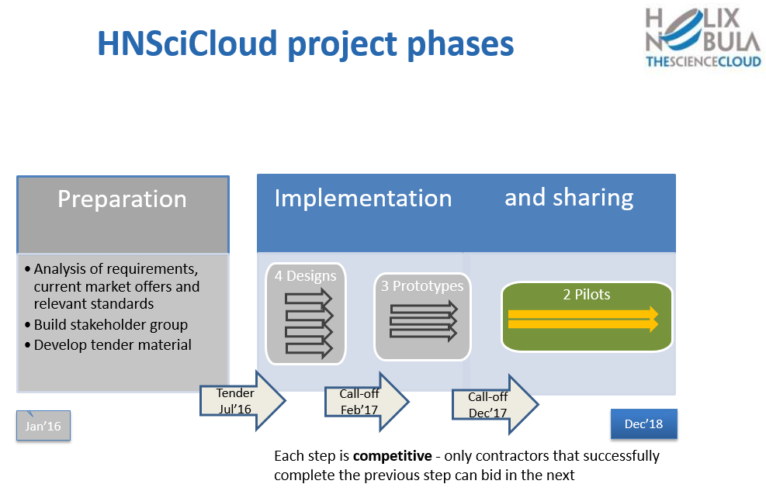

Slide 11
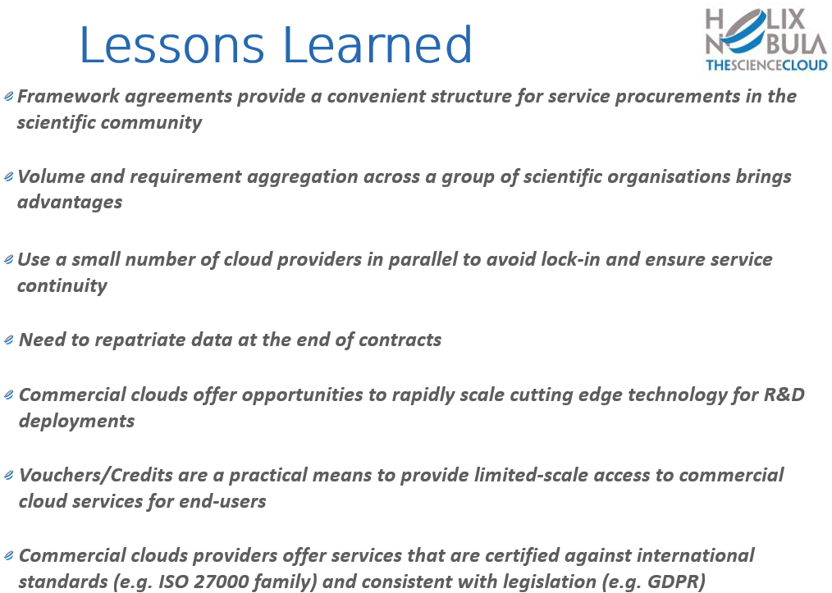

Slide 12
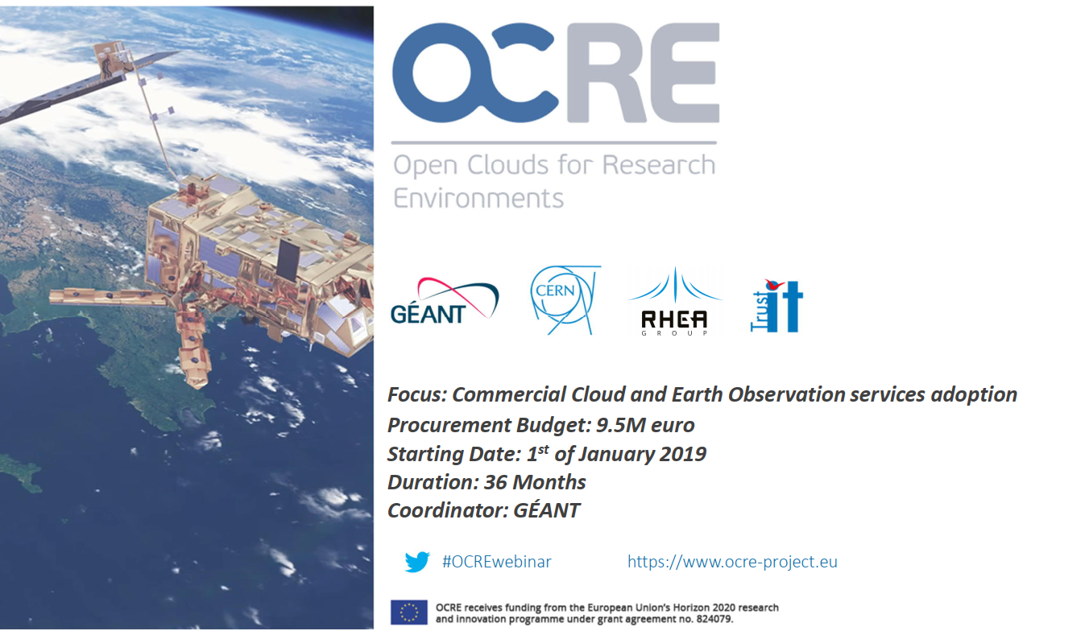
OCRE – Open Clouds for Research Environments

Slide 13
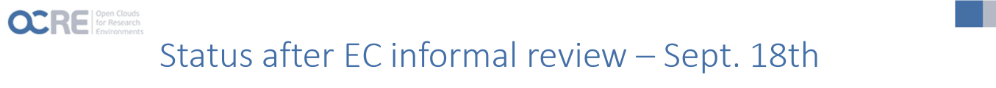
OCRE is considered of strategic relevance in the context of the EOSC
OCRE and ARCHIVER key to engage commercial service providers
OCRE targets LongTail of Science and EARTH Observation as priorities
500k vouchers contracted via three providers: CloudSigma and resellers of AWS & Azure
Next Steps
Tender material must be formally approved by EC before publication: publication probably delayed Jan/Feb 2020

Slide 14
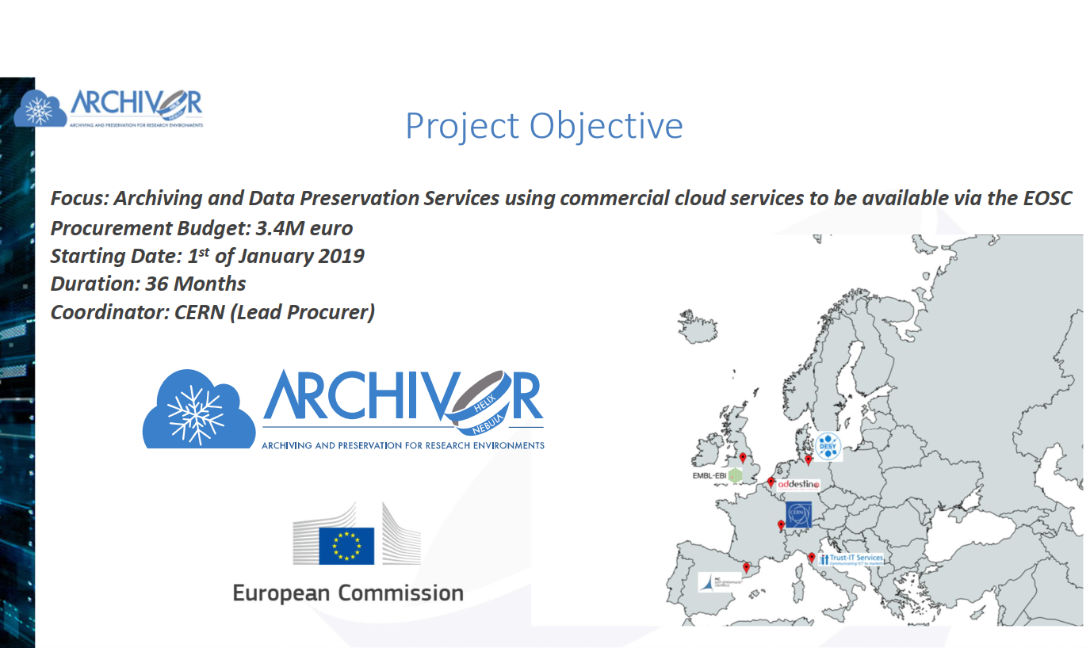

Slide 15
Thank you for your attention
dimper@esrf.eu

